Slide 1
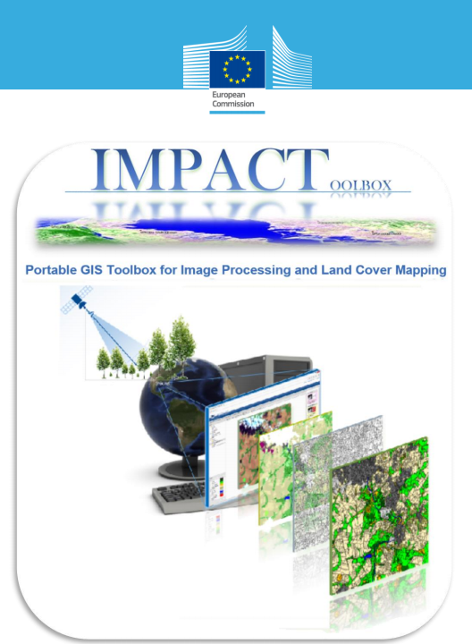
LAND COVER CLASSIFICATION WITH THE IMPACT TOOL
Example with Landsat 8 Images

Slide 2
Contents:
Impact Tool
Landsat 8 Imagery
Graphical User Interface
Main Panel
Processing Modules:
  Zip to geotiff
  Digital Number (DN) to Top-of-Atmosphere (TOA) Reflectances
  Clip
  Classification
  Linear Spectral Unmixing (LSU)
References

Slide 3
Impact Tool:
The IMPACT tool is a portable browser-based application for image processing, visualization and mapping running under Microsoft Windows .
The IMPACT toolbox has been designed to offer a combination of functions for remote sensing, photo interpretation and processing technologies in a portable and stand-alone GIS environment,
No installation or virtual machines are required and therefore the package can be copied onto a portable device for easy execution and data sharing.

Slide 4
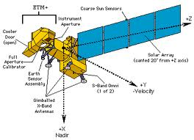
Landsat 8 Imagery
8 bands: B, G, R, NIR, MIR (2), thermal, panchromatic
Across-track scanner
Spatial resolution (IFOV):
  30m for Bands 1 to 7
  15m for panchromatic band
  60m for thermal band
Can collect in two gain settings (high or low) for increased radiometric sensitivity and dynamic range
Vastly improved internal calibration
8 bit data format
Launched February 2013

Slide 5
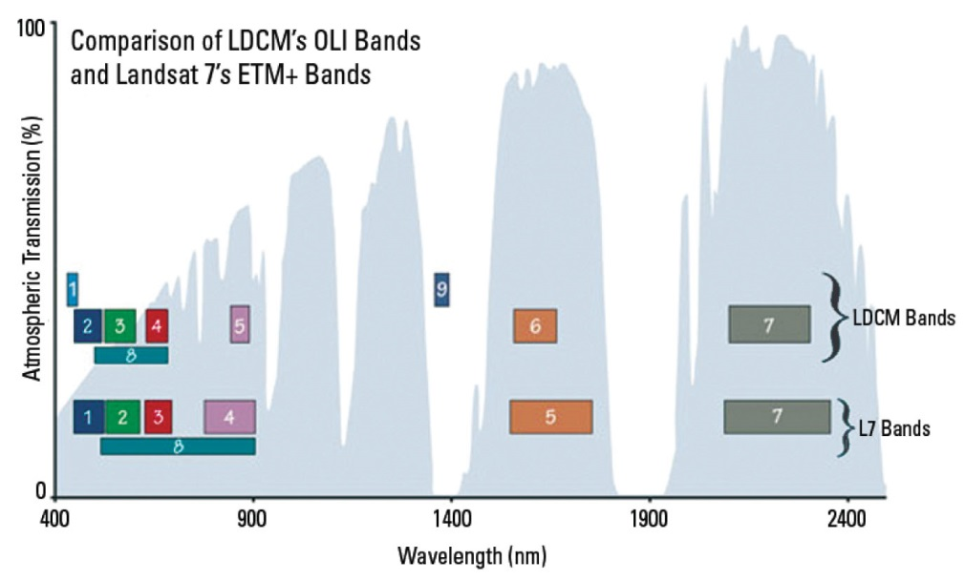
Landsat 8: Operational Land Imager (OLI) and Thermal Infrared Sensor (TIRS)
Landsat 8 Imagery
11 bands: coastal aerosol, cirrus cloud and 2nd thermal band added

Slide 6
Graphical User Interface
Structure:
- DATA: contains user’s vector and raster data and has been divided into subfolders reflecting the different processing steps;
- Gui : contains the graphical user interface, dependencies and map editing functions;
- OSGeo4W: contains the engine and all dependencies such as the OSGeo4W distribution with Apache, Python, GDAL, Openlayers, Mapserver, GeoExt, Javascript and HTML.
- Tools: contains a dedicated folder for each processing module or external library/package used within the tool such as a portable version of Firefox under “Browser”, python scripts for image classification, segmentation, clipping etc.
-START_Impact.bat: windows executable files to start the IMPACT tool;

Slide 7
Main Panel:
The Main Panel is the IMPACT’s desktop from where is possible to monitor available raster and vector layers (left panel), visualize them on the map (central panel) and execute processing modules available on the right panel.

Slide 8
Processing Modules:
  Zip to geotiff
By executing this module, Landsat TM/ETM+/OLI zipped (.tar.gz or .tar.bz) archives placed in the DATA/RAW_data directory will be processed and converted into a single Geo Tiff file

Slide 9
Processing Modules:
  Digital Number (DN) to Top-of-Atmosphere (TOA) Reflectances
By converting the raw digital number (DN) values to top-of-atmosphere (TOA) reflectance data from different sensors/platforms are calibrated to a common radiometric scale, minimizing spectral differences caused by acquisition time, sun elevation, and sun–earth distance.

Slide 10
Processing Modules:
Clip
The user has the possibility to clip any GeoTiff file from the input CALIBRATED_data directory using predefined vector layer(s) containing one or more features each.

Slide 11
Processing Modules:
Classification
The aim of this tool is to offer a fully automatic pixel-based classification product to be used in further processing steps like segmentation and land cover mapping. The Single Date Classification (SDC) algorithm as described and implemented in [Simonetti et al.], is based on pre-defined knowledge-based “fuzzy” rules aiming to convert the TOA reflectance input bands into discrete thematic classes.

Slide 12
Processing Modules:
Classification:
In brief, the classification chain is based on 2 steps:
1) NDVI partition into 3 broad categories as follow : [-1,0] = water; ]0,0.45] = soil; [0.45,1] = vegetation;
2) ad-hoc bands conditions (e.g. NIR > RED > 0.5) to split each category in sub-classes and eventually, promote pixels to other categories as it might happen e.g. for turbid water when having NDVI values > 0 (falling into soil range) .
See Simonetti et al. in References

Slide 13
Processing Modules: Linear Spectral Unmixing
The Linear Spectral Unmixing (LSU) is a tool to decompose the pixels into the abundance of its components, reducing the image dimensionality while still preserving most information required for post processing and mapping activity.

Slide 14
Processing Modules:
Segmentation
Image segmentation is the process of partitioning a digital image into multiple segments on the base spectral, geometrical or computed properties (texture) together with user defined parameter describing the size, shape and similarity versus adjacent segments. Baatz algorithm [ref] is available as an open-source package from INPE’s TerraLib operators [ref].

Slide 15
References
Simonetti
Baetz
…

